Slide 1
Vegetation Dynamics from NDVI Time Series Analysis at Carmel Valley
Jeff Yen
Department of Geography, San Diego State University
#RemoteSensing #changedetection #VEGEtationDYNAMics

Slide 2
Project Motivation
Remote sensing (RS) imagery has been most commonly used to conduct LULC change analysis because of the ability to observe landscape across regions in a synoptic and timely.
Vegetation is the majority of land covers on earth, understanding vegetation dynamics is important to promote our lives in many perspectives (e.g., urban planning and management).
Previous research on vegetation dynamics primarily emphasizes on the area of vegetation change, though the few focuses on the speed of vegetation change.

Slide 3
Project Objectives
To provide more comprehensive aspects of vegetation dynamics based on three indicators:
Vegetation NDVI value change
Speed of vegetation NDVI value change
Acceleration of vegetation NDVI value change
To automate image processing routines via Python 2.7 and ArcPy

Slide 4
Data
Four images (2010, 2012, 2014, 2016) were collected from National Agriculture Imagery Program (NAIP) using Google Earth Engine (GEE).
The collected NAIP images have the following characteristics:
Spatial resolution: 1 m
Spectral resolution: R, G, B, NIR
Radiometric resolution: 8-bit unsigned (0 – 255)

Slide 5
Methods
The entire image processing routine is divided into three parts:
Reading image information from .csv file
Classifying vegetation
Binary vegetation classification based on given NDVI thresholds
Performing vegetation dynamics based on NDVI time-series change detection
Vegetation NDVI value change: T1(2012-2010), T2(2014-2012), T3(2016-2014)
Speed of vegetation NDVI value change: S1:(T2-T1)/2, S2:(T3-T2)/2
Acceleration of vegetation NDVI value change: A1: (S2-S1)/2

Slide 6
Method – Cont.
The following ArcPy methods were adopted to complete certain stage of this project:
arcpy.GetParameterAsText
arcpy.env.workspace
arcpy.CheckOutExtension
arcpy.AddMessage
arcpy.Raster
arcpy.GetRasterProperties_management
arcpy.sa
Int
Float
SetNull
RemapRange
Reclassify

Slide 7
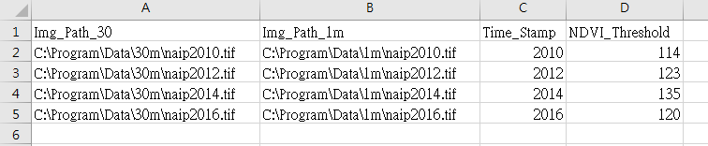
Reading image information from .csv file
Attribute in .csv file:
Time-efficient user input and great reusability

Slide 8

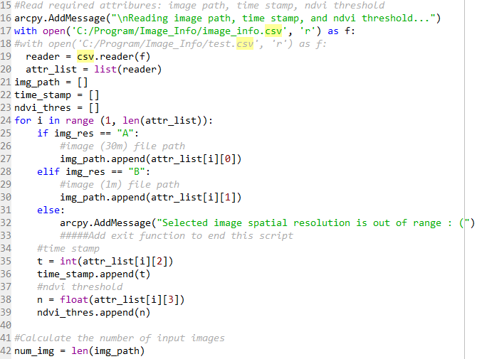
Reading image information from .csv file – cont.
<= Get image resolution from user, either 30m or 1m
skip the first row, which is the each field name
<= read and append image information into lists
(i.e., image path, time stamp, ndvi threshold)
<= Calculate the number of image input to iteratively classify vegetation and execute NDVI time-series change detection

Slide 9
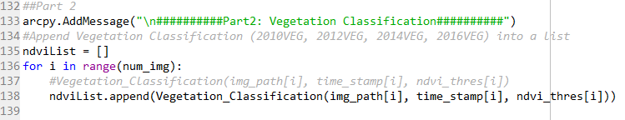
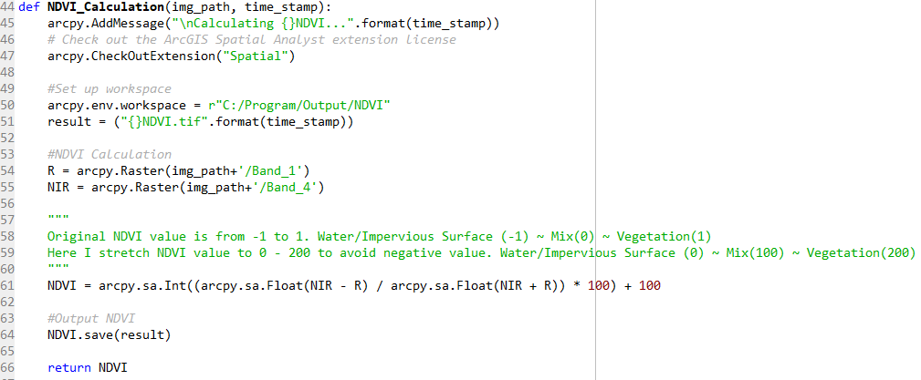
Classifying vegetation
<= iteratively classify vegetation and append NDVI time-series to a list
<= Calculate NDVI

Slide 10
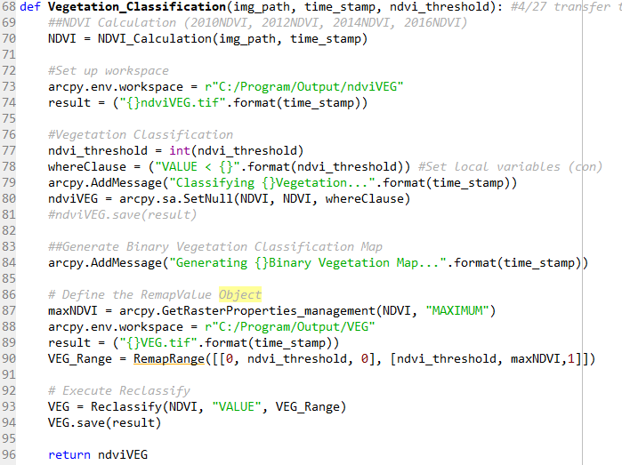
Classifying vegetation – Cont.
<= Classify Vegetation and create binary vegetation classification map

Slide 11
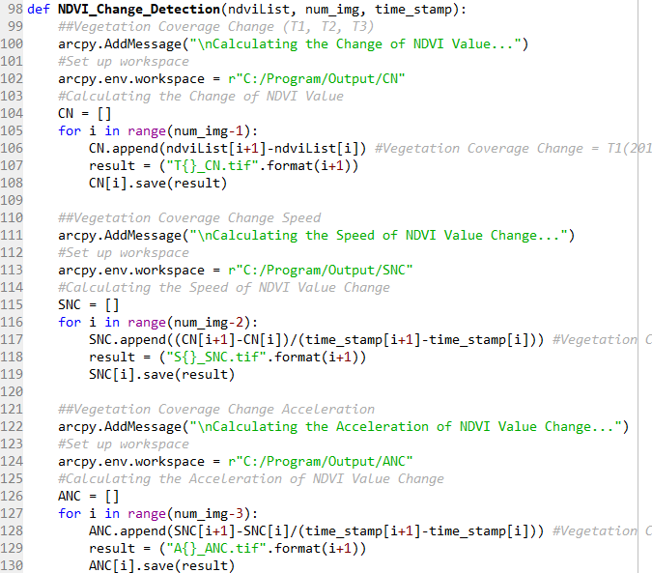
Performing NDVI time-series change detection
<= input parameters for change detection
<= calculate three indicators for NDVI time-series change detection

Slide 12
ResultS

Slide 13
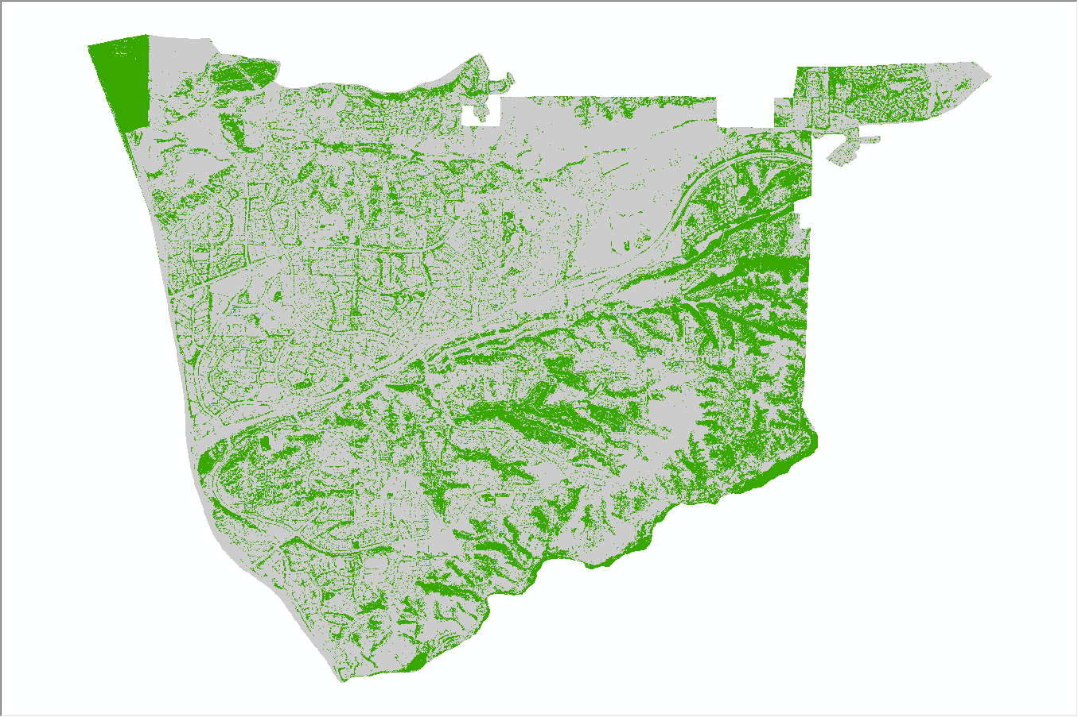
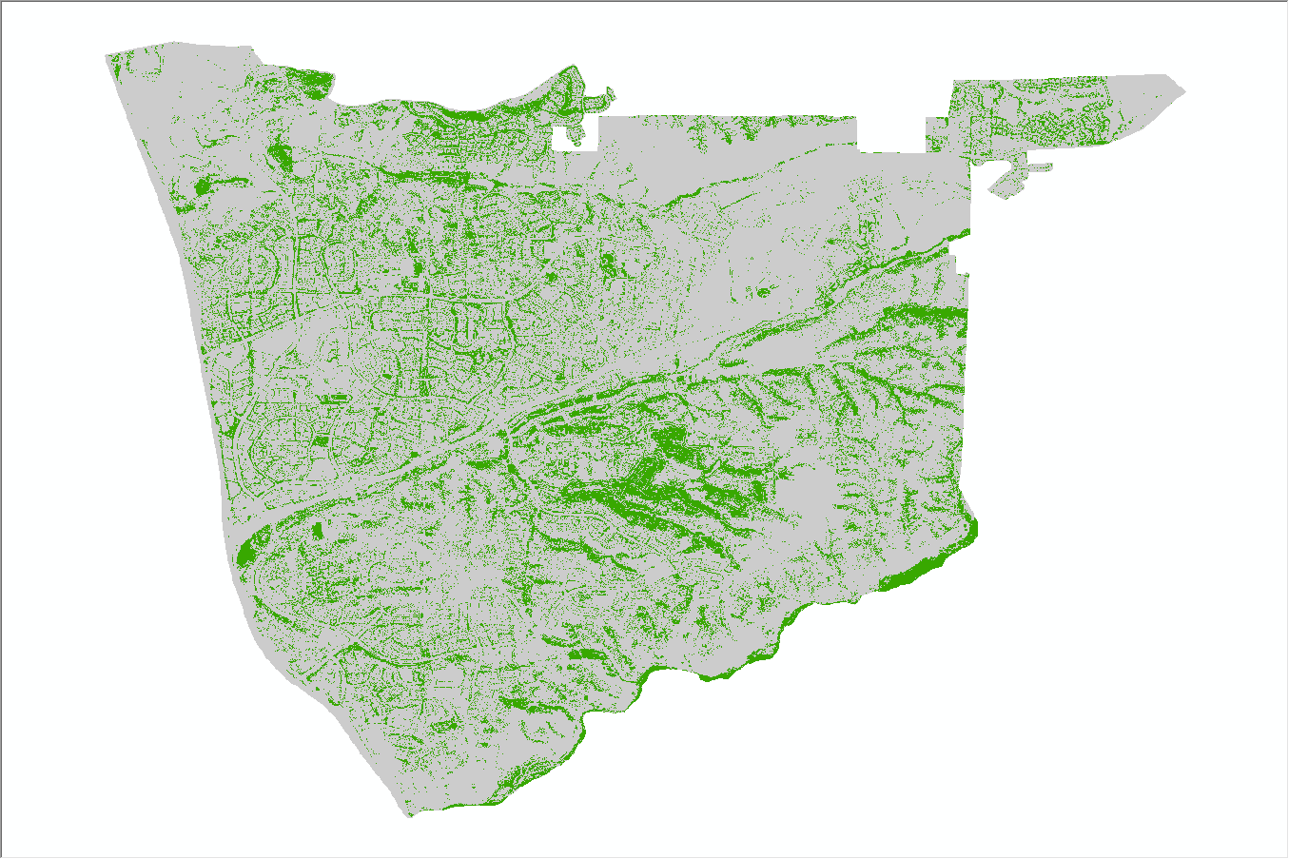

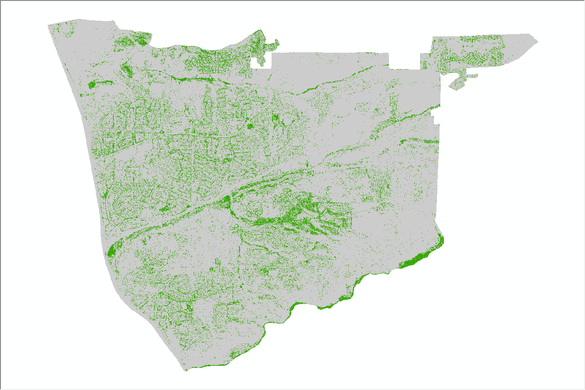
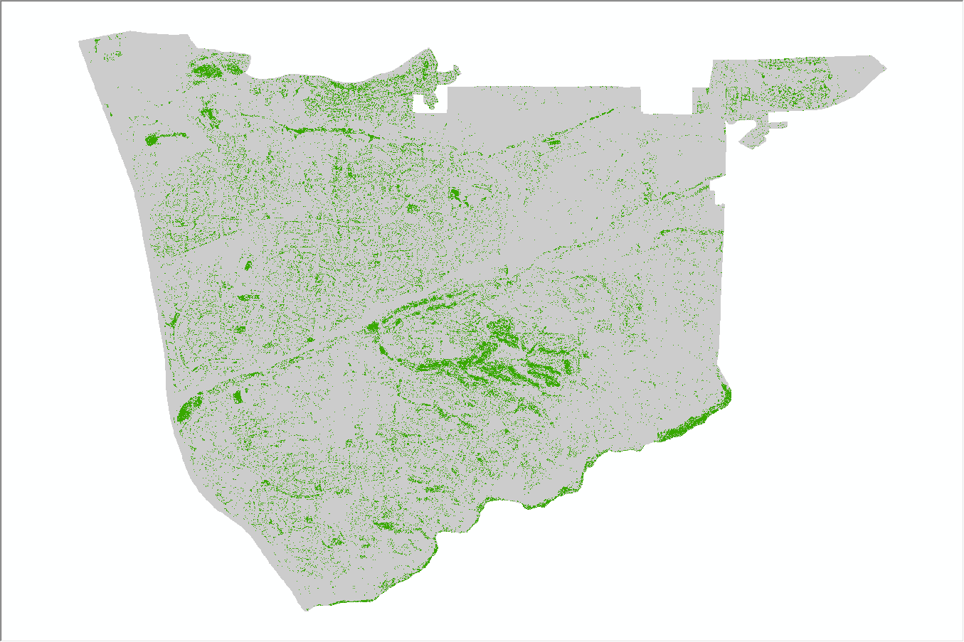
Vegetation Classification
2010
2012
2014
2016

Slide 14
Summary of Vegetation Classification
Year | Vegetation Coverage (m^2) | Percentage of Vegetation Coverage (%)
2010 | 45423760 | 16.1
2012 | 32251308 | 11.4
2014 | 20784488 | 7.4
2016 | 14123916 | 5.0

Slide 15
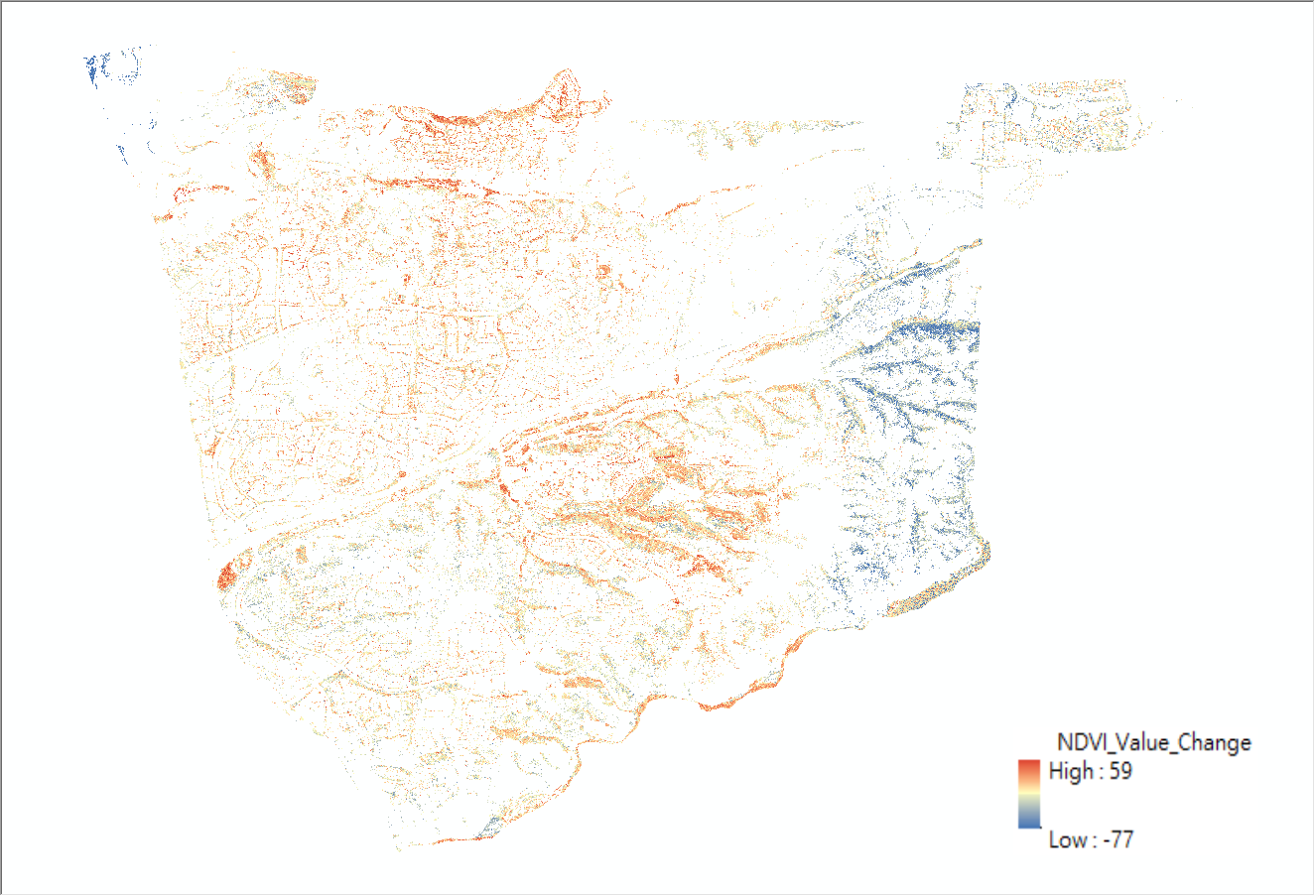
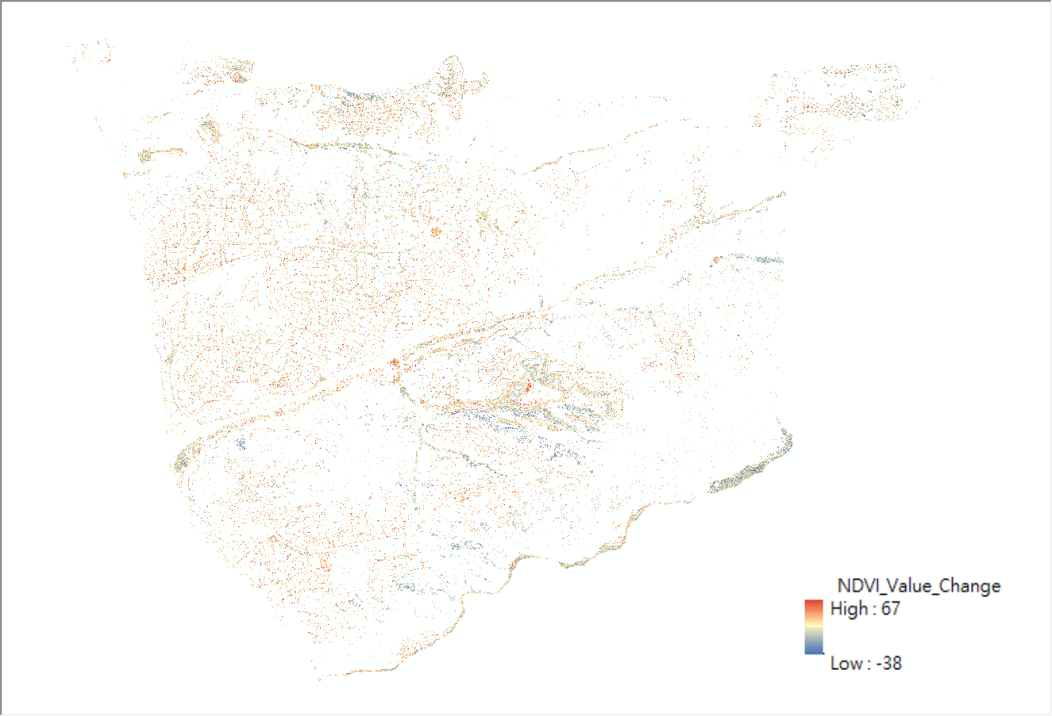
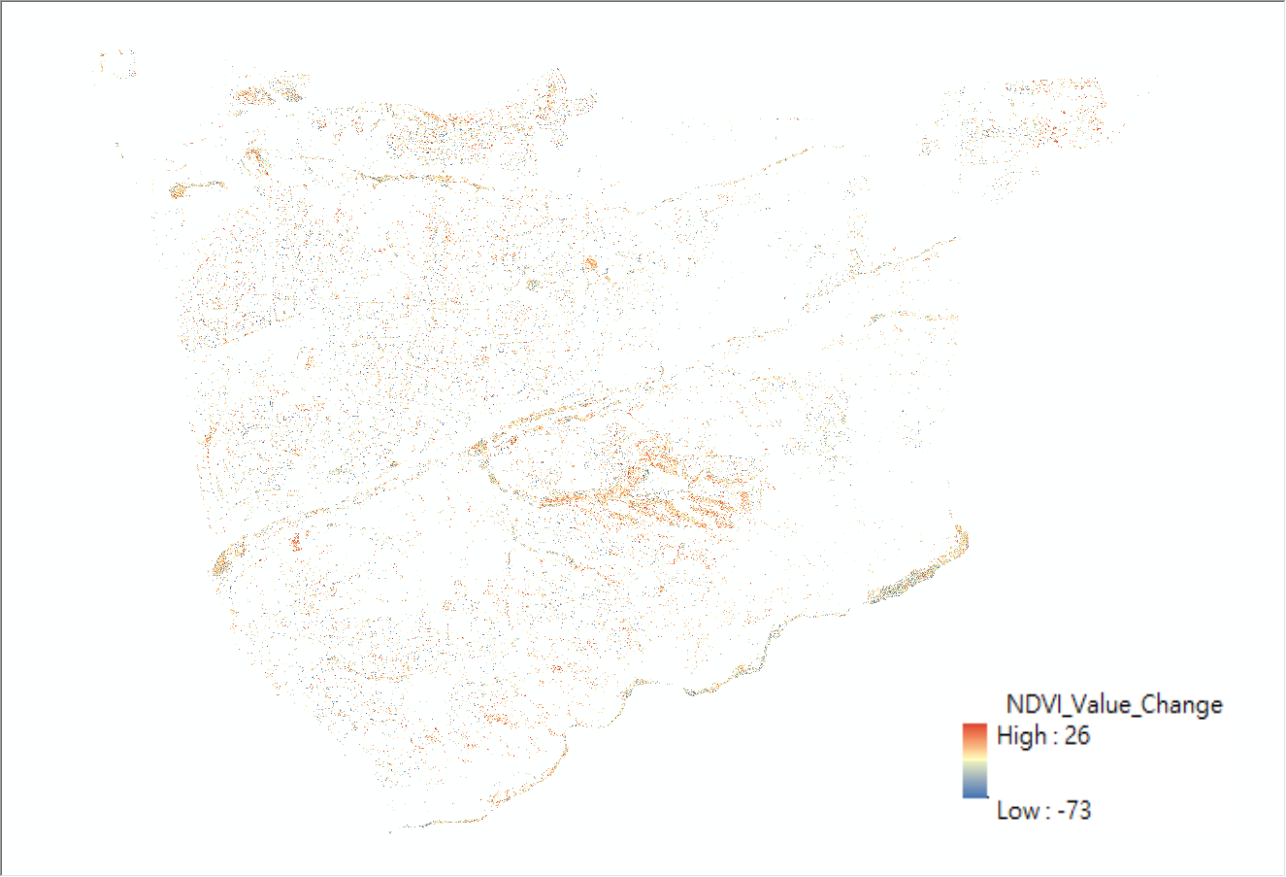
Vegetation NDVI Value CHANGE
T1: 2012-2010
T2: 2014-2012
Time | Avg. VEG_NDVI Value Change | Std. VEG_NDVI Value Change
T1 (2012 - 2010) | 13.55 | 10.68
T2 (2014 - 2012) | 7.54 | 11.73
T3 (2016 - 2014) | -20.08 | 9.86
T3: 2016-2014

Slide 16
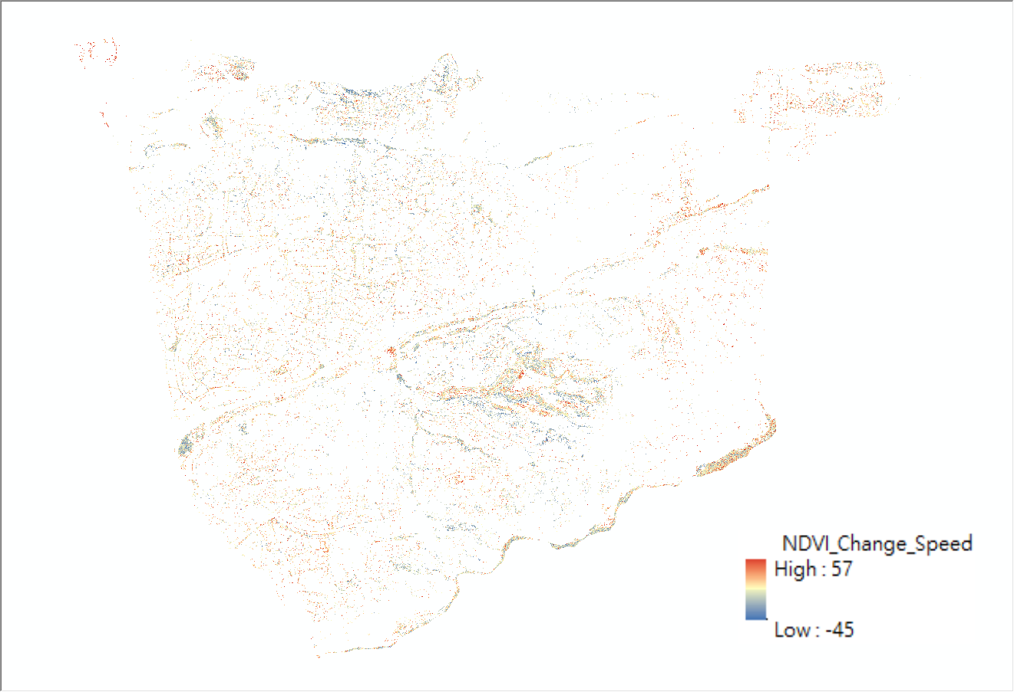
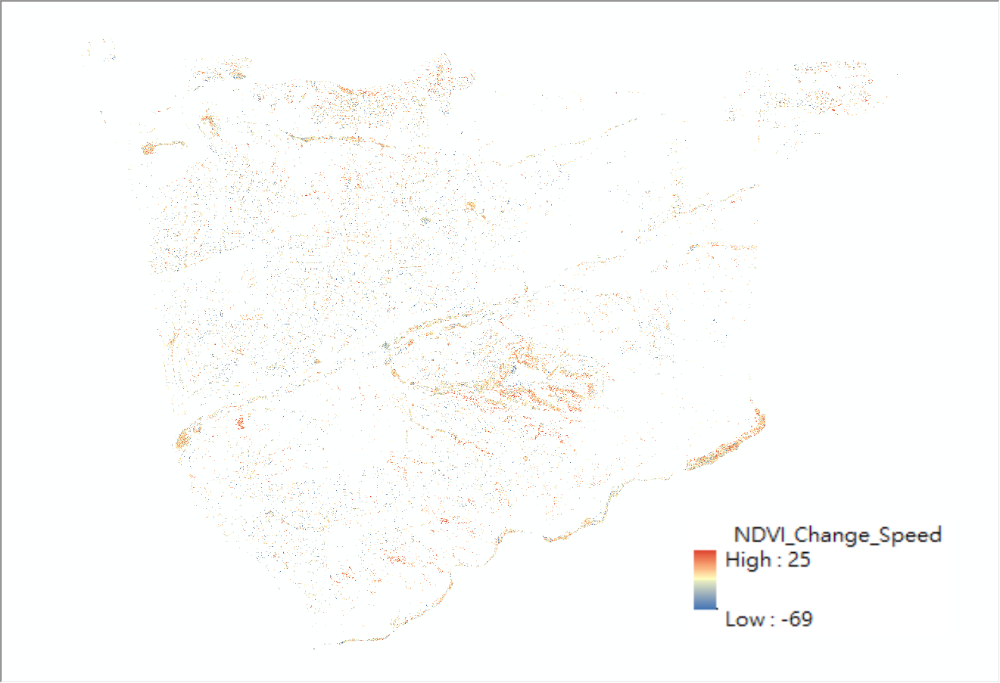
The Speed of Vegetation NDVI Value CHANGE
S1: (T2-T1)/2
S2: (T3-T2)/2
Time | Avg. Speed of VEG_NDVI Value Change | Std. Speed of VEG_NDVI Value Change
S1:(T2-T1)/2 | -5.73 | 8.93
S2:(T3-T2)/2 | -13.41 | 9.69

Slide 17
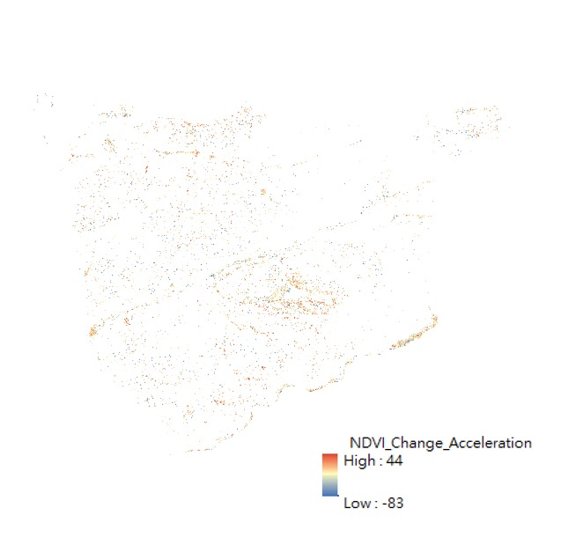
The Acceleration of Vegetation NDVI Value CHANGE
Time | Avg. Acceleration of VEG_NDVI Value Change | Std. Acceleration of VEG_NDVI Value Change
A1:(S2-S1)/2 | -8.94 | 13.03
A1: (S2-S1)/2

Slide 18
Limitations, Challenges and Problems
Limitations:
Subjective NDVI threshold
Per-pixel-based classification
Challenges:
Reduce computational time of 1m NAIP images
Compact the python script
Difficulty in appropriately visualizing the results
Problems:
Unable to incorporate third-party python libraries unless setting global environment in Windows OS.

Slide 19
Thank You!!
Q&A
Contact: cyen@sdsu.edu

